Slide 1
Employee Data Analysis using Excel
STUDENT NAME : JANANI.P
REGISTER NO : 312201621
DEPARTMENT : COMMERCE B.COM(GENERAL)
COLLEGE : PROF. DHANAPALAN COLLEGE OF SCIENCE
AND MANAGEMENT

Slide 2
PROJECT TITLE
Employee Performance Analysis using Excel

Slide 3


AGENDA
Problem Statement
Project Overview
End Users
Our Solution and Proposition
Dataset Description
Modelling Approach
Results and Discussion
Conclusion
3/21/2024 Annual Review

Slide 4

PROBLEM STATEMENT
1.Identify Trends: Analyze employee data to uncover trends in staff performance and retention rates.
2.Assess Correlations: Use Excel to explore relationships between employee tenure, productivity metrics, and departmental performance.
Generate Visualizations: Create charts and graphs to visualize key insights and trends from the data.
Provide Recommendations: Offer actionable recommendations for improving workforce management based on the analysis and effectiveness of current HR strategies.

Slide 5

PROJECT OVERVIEW
Objective: Analyze employee data to uncover trends in performance and retention.
Data Sources: Employee records, performance reviews, and departmental metrics.
Approach: Clean and preprocess data, identify trends, assess correlations.
Key Variables: Tenure, job role, performance scores, productivity metrics.
Visualization: Use Excel charts and graphs to represent insights.
Findings: Discover trends in employee performance and retention rates.
Correlations: Examine relationships between tenure, productivity, and departmental success.
Recommendations: Propose actionable improvements for workforce management.
Next Steps: Develop an implementation plan and suggest areas for further analysis.
Conclusion: Summarize insights and invite questions for further discussion.
.

Slide 6

WHO ARE THE END USERS?
The end users of the employee data analysis conducted using Excel are typically key stakeholders within the organization, including Human Resources (HR) managers, department heads, and senior executives. HR managers rely on this analysis to refine recruitment strategies, improve employee retention, and enhance overall workforce management. Department heads use the insights to assess team performance and productivity, facilitating targeted interventions and support where needed. Senior executives benefit from a high-level overview of workforce trends and performance metrics, which aids in strategic decision-making and aligning HR practices with organizational goals. Additionally, the analysis can serve as a valuable resource for business analysts and consultants who may be involved in advising on workforce optimization strategies.

Slide 7

OUR SOLUTION AND ITS VALUE PROPOSITION
💦Enhanced Decision-Making: Provides actionable insights into employee performance and retention trends, enabling informed strategic decisions.
💦Data-Driven HR Strategies: Supports the development of targeted HR policies and practices to improve recruitment, training, and employee retention.
💦Increased Efficiency: Streamlines the analysis process with Excel’s powerful tools, saving time and resources while delivering comprehensive insights.
💦Visual Insights: Utilizes Excel’s visualization capabilities to clearly present data trends and correlations, making complex information easily understandable.
💦Performance Optimization: Identifies key factors affecting employee productivity, allowing for targeted interventions to enhance overall workforce effectiveness.
💦Strategic Planning: Facilitates better alignment of HR initiatives with organizational goals through detailed analysis and trend forecasting.

Slide 8
Dataset Description
The dataset for employee data analysis in Excel includes several key components that provide a comprehensive view of each employee's profile and performance. Employee ID serves as a unique identifier for tracking and referencing individuals within the dataset. Name captures the full name of each employee, while Department and Job Title provide context on their role within the organization. The Hire Date allows calculation of Tenure, indicating how long the employee has been with the company. Performance Score and Productivity Metrics offer insights into employee effectiveness and output. Salary details financial compensation, and Promotion History tracks career advancement within the company. Absenteeism records the number of days employees have been absent and reasons for their leave, while Training and Development logs participation in professional growth opportunities. Employee Status indicates current employment conditions, and Location specifies the employee’s base office or remote working arrangement. Finally, Supervisor ID links each employee to their direct supervisor, facilitating hierarchical analysis. Together, these components enable a thorough examination of employee data to inform HR strategies and organizational decisions.

Slide 9

THE "WOW" IN OUR SOLUTION
Deep Insights: Reveal hidden trends and correlations in employee performance and retention, offering a deeper understanding of workforce dynamics.
Empowered Decision Making: Equip HR and management with actionable data-driven insights, enabling strategic decisions based on solid evidence.
Stunning Visualizations: Leverage Excel’s powerful charting tools to turn complex data into clear, impactful visuals that communicate key findings effectively.
Optimized Workforce Strategies: Enhance recruitment, training, and resource allocation by identifying critical factors that impact employee satisfaction and productivity.
Predictive Analytics: Use historical data to anticipate future trends and challenges, allowing for proactive strategies and better strategic planning.
3/21/2024 Annual Review
9

Slide 10
MODELLING
1.Data Input and Integration: Import and consolidate employee data from various sources into Excel for a unified analysis.
2.Data Cleaning and Transformation: Cleanse the data by removing duplicates, correcting errors, and standardizing formats to ensure accuracy.
Trend Analysis: Utilize PivotTables and charts to examine trends in employee performance and retention over time.
Correlation and Pattern Detection: Apply correlation functions and create scatter plots to identify relationships between variables such as tenure and productivity.
Visualization and Reporting: Develop dashboards and visual reports to effectively communicate insights and support decision-making.
10

Slide 11
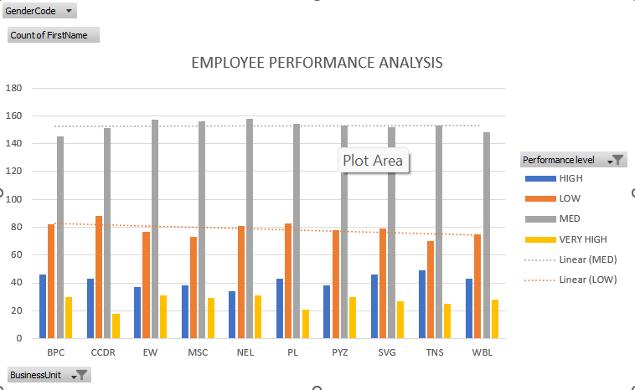
RESULTS
11

Slide 12
conclusion
The employee data analysis conducted using Excel has provided valuable insights into workforce performance and retention. By integrating and cleansing data, we were able to identify key trends and correlations that inform strategic HR decisions. The use of PivotTables and charts has highlighted areas for improvement, while predictive analytics offer foresight into future trends. The resulting visual reports and dashboards present these insights in an actionable format, empowering management to make data-driven decisions that enhance employee satisfaction and optimize workforce efficiency. Overall, this analysis supports a more strategic approach to managing and developing human resources within the organization.

